Slide 1






Database Systems
SQL
DBMS Basic Concepts
Databases
SoftUni Team
Technical Trainers
Software University
http://softuni.bg

Slide 2


Table of Contents
Database Models
Relational Database Model
DBMS & RDBMS Systems
Tables, Relationships, Multiplicity, E/R Diagrams
Normalization
Constraints
Indices
The SQL language

Slide 3



Table of Contents (2)
Stored Procedures
Views
Triggers
Transactions and Isolation Levels
NoSQL Databases

Slide 4


RDBMS Systems
Relational Databases, Database Servers and RDBMS

Slide 5

Relational Databases
Database models
Hierarchical (tree)
Network / graph
Relational (tables)
Object-oriented
Relational databases
Represent a bunch of tables together with the relationships between them
Rely on a strong mathematical foundation: the relational algebra

Slide 6
Relational Database Management System
Relational Database Management Systems (RDBMS) manage data stored in tables
RDBMS systems typically implement
Creating / altering / deleting tables and relationships between them (database schema)
Adding, changing, deleting, searching and retrieving of data rows stored in the tables
Support for the SQL language
Transaction management (optional)

Slide 7
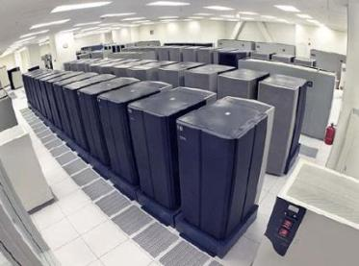

RDBMS Systems
RDBMS systems are also known as:
Database management servers
Or just database servers
Popular RDBMS servers:
Microsoft SQL Server
Oracle Database
MySQL
PostgreSQL
SQLite

Slide 8

Tables and Relationships
Database Tables, Relationships, Multiplicity

Slide 9
Tables
Database tables consist of data, arranged in rows and columns
For example (table Persons):
All rows have the same structure
Columns have name and type (number, string, date, image, …)
Id | First Name | Last Name | Employer
1 | Svetlin | Nakov | SoftUni
2 | Hristo | Tenchev | XS Software
3 | Vladimir | Georgiev | SoftUni

Slide 10
Table Schema
The schema of a table is an ordered sequence of column specifications (name and type)
For example the Persons table has the following schema:
Persons (
Id: number,
FirstName: string,
LastName: string,
Employer: string
)

Slide 11
Primary Key
Primary key is a column of the table that uniquely identifies its rows (usually its is a number)
Two records (rows) are different if and only if their primary keys are different
Composite primary key – composed by several columns
Id | First Name | Last Name | Employer
1 | Svetlin | Nakov | SoftUni
2 | Hristo | Tenchev | XS Software
3 | Vladimir | Georgiev | SoftUni
Primary key

Slide 12
Relationships
Relationships between tables are based on interconnections: primary key / foreign key
Primary Key
Towns
Foreign Key
Primary Key
Countries
Id | Name | CountryId
1 | Sofia | 1
2 | Varna | 1
3 | Munich | 2
4 | Berlin | 2
5 | Moscow | 3
Id | Name
1 | Bulgaria
2 | Germany
3 | Russia

Slide 13
Relationships (2)
The foreign key is an identifier of a record located in another table (usually its primary key)
By using relationships we avoid repeating data in the database
In the last example the name of the country is not repeated for each town (its number is used instead)
Relationships have multiplicity:
One-to-many – e.g. country / towns
Many-to-many – e.g. student / course
One-to-one – e.g. example human / student

Slide 14
Relationships' Multiplicity – One-To-Many
Relationship one-to-many (or many-to-one) – used often
A single record in the first table has many corresponding records in the second table
Towns
Id | Name | CountryId
1 | Sofia | 1
2 | Varna | 1
3 | Munich | 2
4 | Berlin | 2
5 | Moscow | 3
Countries
Id | Name
1 | Bulgaria
2 | Germany
3 | Russia

Slide 15
Relationships' Multiplicity – Many-To-Many
Relationship many-to-many
Records in the first table have many corresponding records in the second one and vice versa
Implemented through additional table
StudentsCourses
Students
Id | Name
1 | Pesho
2 | Minka
3 | Gosho
4 | Jivka
StudentId | CourseId
1 | 1
1 | 2
3 | 2
3 | 3
4 | 2
Courses
Id | Name
1 | .NET
2 | Databases
3 | JavaScript

Slide 16
Relationships' Multiplicity – One-To-One
Relationship one-to-one
A single record in a table corresponds to a single record in the other table
Used to model inheritance between tables
Primary & foreign key
Professors
Primary & foreign key
Primary Key
Id | Title
1 | Ph.D.
Persons
Id | Name | Age
1 | Baba Mara | 67
2 | Stancho | 33
3 | Bay Gosho | 45
Students
Id | Specialty
2 | Computer Science
3 | Chemistry

Slide 17


Representing Hierarchical Data
How do we represent trees and graphs?
Root
Documents
Pictures
My Parties
Birthday Party
Summer 2015

Slide 18
Self-Relationships
The primary / foreign key relationships can point to one and the same table
Example: folders hold sub-folders
Primary Key
Foreign Key
Self-Relationship
Folders
Id | Folder | ParentId
1 | Root | NULL
2 | Documents | 1
3 | Pictures | 1
4 | Birthday Party | 3

Slide 19
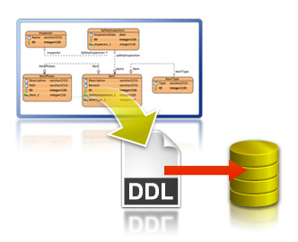
E/R Diagrams
Entity / Relationship Diagrams and DB Modeling Tools

Slide 20
Relational Schema
Relational schema of a DB is the collection of:
The schemas of all tables
Relationships between the tables
Any other database objects (e.g. constraints)
The relational schema describes the structure of the database
Doesn't contain data, but metadata
Relational schemas are graphically displayed in Entity / Relationship diagrams (E/R Diagrams)

Slide 21
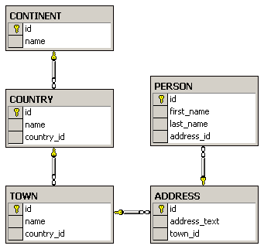
E/R Diagrams – Examples
The diagram is created with Microsoft SQL Server Management Studio

Slide 22
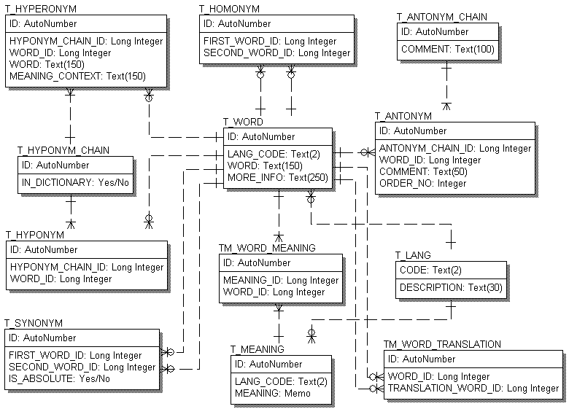
E/R Diagrams – Examples (2)
The diagram is created with ERwin

Slide 23
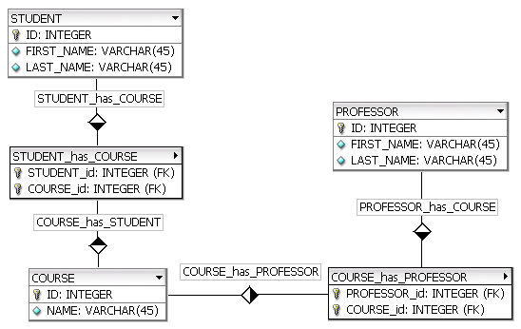
E/R Diagrams – Examples (3)
The diagram is created with fabFORCE DB Designer for MySQL

Slide 24
E/R Diagrams – Examples (4)
The diagram is created with MS Visio

Slide 25

Tools for E/R Design
Data modeling tools allow building E/R diagrams, generate / import DB schemas:
SQL Server Management Studio
MySQL Workbench
Oracle JDeveloper
Microsoft Visio
CASE Studio
Computer Associates ERwin
IBM Rational Rose

Slide 26


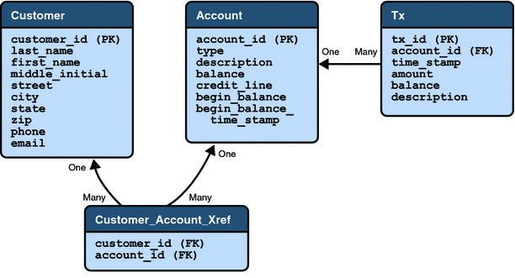

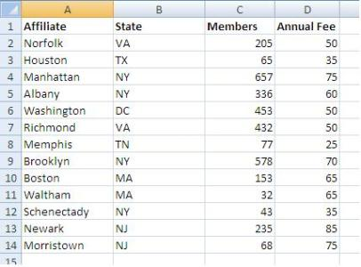
DB Normalization
Avoiding Duplicated Data through Database Schema Normalization

Slide 27
Normalization
Normalization of the relational schema removes repeating data
Non-normalized schemas can contain many repeated data, e.g.
Product | Producer | Price | Category | Shop | Town
yoghurt | Mlexis Ltd. | 0.67 | food | store "Mente" | Sofia
bread "Dobrudja" | Bakery "Smoky" | 0.85 | food | store "Mente" | Sofia
beer "Zagorka" | Zagorka Corp. | 0.68 | soft drinks | stall "non-stop" | Varna
beer "Tuborg" | Shoumen Drinks Corp. | 0.87 | soft drinks | stall "non-stop" | Varna

Slide 28
Normalization (2)
1-st Normal Form
Data is stored in tables
Fields in the rows are atomic (inseparable) values
There are no repetitions within a single row
A primary key is defined for each table
BookTitle | ISBN (PK) | Author | AuthorEmail
.NET Framework | 3847028437 | Mr. Kiro | bai-kiro@abv.bg
Beginning SQL | 7234534450 | Santa Claus | dedo@mraz.org

Slide 29
Normalization (3)
2-nd Normal Form
Retains all requirements of 1-st Normal Form
There are no columns that do not depend on part of the primary key (if it consists of several columns)
The price depends on the book
E-mail depends on the author
BookTitle (PK) | Author (PK) | Price | AuthorEmail
.NET Framework | Mr. Kiro | 37.25 | bai-kiro@abv.bg
Beginning SQL | Santa Claus | 19.95 | dedo@mraz.org

Slide 30
Normalization (4)
3-rd Normal Form
Retains all requirements of 2-nd Normal Form
The only dependencies between columns are of type "a column depends on the PK"
Id | Product | ProducerId | Price | CategoryId | ShopId | TownId
1 | yoghourt | 2 | 0.67 | 2 | 4 | 1
2 | bread "Tipov" | 3 | 0.85 | 2 | 4 | 1
3 | rakiya "Biserna" | 6 | 6.83 | 5 | 2 | 1
4 | beer "Tuborg" | 4 | 0.87 | 4 | 1 | 3

Slide 31
Normalization (5)
4-th Normal Form
Retains all requirements of 3-rd Normal Form
There is one column at most in each table that can have many possible values for a single key (multi-valued attribute)
One author can have many books
One author can have many articles
Id | Book | Article
2 | .NET Programming | Regular Expressions
4 | Mastering JavaScript | AJAX Performance Patterns

Slide 32
Normalization (6)
Example of fully normalized schema (in 4th Normal Form):
Products
Id | Product | ProducerId | Price | CategoryId | ShopId | TownId
1 | Youghurt | 2 | 0.67 | 2 | 4 | 1
2 | bread "Dobrudja" | 3 | 0.55 | 2 | 4 | 1
3 | rakia "Peshtera" | 6 | 4.38 | 5 | 2 | 1
4 | beer "Tuborg" | 4 | 0.67 | 4 | 1 | 3
Producers
Categories
Shops
Towns
Id | Name
2 | "Milk" Ltd.
4 | "Zagorka" AD
Id | Name
4 | beer
2 | food
Id | Name
1 | Billa
4 | METRO
Id | Name
1 | Sofia
3 | Varna

Slide 33

Other Database Objects
Constraints, Indices, SQL, Stored Procedures, Views, Triggers

Slide 34
Integrity Constraints
Integrity constraints ensure data integrity in the database tables
Enforce data rules which cannot be violated
Primary key constraint
Ensures that the primary key of a table has unique value for each table row
Unique key constraint
Ensures that all values in a certain column (or a group of columns) are unique

Slide 35
Integrity Constraints (2)
Foreign key constraint
Ensures that the value in given column is a key from another table
Check constraint
Ensures that values in a certain column meet some predefined condition
Examples:
(hour >= 0) AND (hour < 24)
name = UPPER(name)

Slide 36
Indices
Indices speed up searching of values in a certain column or group of columns
Usually implemented as B-trees
Indices can be built-in the table (clustered) or stored externally (non-clustered)
Adding and deleting records in indexed tables is slower!
Indices should be used for big tables only (e.g. 50 000 rows)

Slide 37
The SQL Language
SQL (Structured Query Language)
Standardized declarative language for manipulation of relational databases
SQL-2011 is currently in use in most databases
http://en.wikipedia.org/wiki/SQL#Standardization
SQL language supports:
DDL: Creating, altering, deleting tables and other DB objects
DML: searching, retrieving, inserting, modifying and deleting table data (data rows)

Slide 38
The SQL Language (2)
SQL consists of:
DDL – Data Definition Language
CREATE, ALTER, DROP commands
DML – Data Manipulation Language
SELECT, INSERT, UPDATE, DELETE commands
Example of SQL SELECT query:
SELECT Towns.Name, Countries.Name
FROM Towns, Countries
WHERE Towns.CountryId = Countries.Id

Slide 39


Stored Procedures
Stored procedures (database-level procedures)
Consist of SQL-like code stored in the database
Code executed inside the database server
Much faster than an external code
Data is locally accessible
Can accept parameters
Can return results
Single value
Record sets

Slide 40
Stored Procedures (2)
Stored procedures are written in a language extension of SQL
T-SQL – in Microsoft SQL Server
PL/SQL – in Oracle
Example of stored procedure in Oracle PL/SQL:
CREATE OR REPLACE PROCEDURE spInsertCountry(countryName varchar2) IS
BEGIN
INSERT INTO Countries(Name)
VALUES(countryName);
END;

Slide 41
Views
Views are named SQL SELECT queries which are used as tables
Simplify data access
Facilitate writing of complex SQL queries
Used also to apply security restrictions:
E.g. a certain user isn't given permissions on any of the tables in the database
The user is given permissions on few views (subset of DB) and few stored procedures only

Slide 42
Views – Example
Companies
Towns
Id | Company | TownId
1 | Mente LTD | 1
2 | BulkSoft Inc. | 2
3 | HardSoft Corp. | 4
4 | Sputnik Corp. | 3
Id | Town | CountyId
1 | Sofia | 1
2 | New York | 3
3 | Moscow | 2
4 | Plovdiv | 1
Countries
Id | Country
1 | Bulgaria
2 | Russia
3 | USA

Slide 43
Views – Example (2)
CREATE VIEW V_BGCompanies AS
SELECT
Companies.Id AS Id,
Companies.Company AS Company
FROM Companies INNER JOIN
(Towns INNER JOIN Countries ON
Towns.CountryId = Countries.Id)
ON Companies.TownId = Towns.Id
WHERE
Countries.Country = "Bulgaria";
Id | Company
1 | Mente Ltd.
3 | HardSoft Corp.
V_BGCompanies

Slide 44


Triggers
Triggers are special stored procedures that are activate when some event occurs, for instance:
When inserting a record
When changing a record
When deleting a record
Triggers can perform additional data processing, e.g.
To change the newly added data
To maintain logs and history on change

Slide 45
Triggers – Example
We have a table holding company names:
A trigger that appends "Ltd." at the end of the name of a new company:
CREATE TABLE Companies(
Id number NOT NULL,
Name varchar(50) NOT NULL)
CREATE OR REPLACE TRIGGER trg_Companies_INSERT
BEFORE INSERT ON Company
FOR EACH ROW
BEGIN
:NEW.Name := :NEW.Name || ' Ltd.';
END;

Slide 46



Transactions
ACID Transactions and Isolation

Slide 47
Transactions
Transactions are a sequence of database operations which are executed as a single unit:
Either all of them execute successfully
Or none of them is executed at all
Example:
A bank transfer from one account into another (withdrawal + deposit)
If either the withdrawal or the deposit fails the entire operation should be cancelled

Slide 48
DB Transactions Lifecycle
Read
Write
Durable starting state
Sequence of reads and writes
Durable,
consistent,
ending state
Write
Commit
Rollback
Notes:
Two possible outcomes of the transaction: It completes successfully (as agreed by unanimous vote of all its participants) or it fails and rolls back to the state before the transaction started
Durable: if the transaction didn’t occur, this state would persist
Analogy: A contract negotiation either results in a successful signed contract, or it fails. There is no intermediate. Similarly, once it is signed, it exists as a whole, it cannot be broken into pieces. It is also durable, lasting as long as specified within the contract.

Slide 49
Transactions Behavior
Transactions guarantee the consistency and the integrity of the database
All changes in a transaction are temporary
Changes become final when COMMIT is successfully executed
At any time all changes done in the transaction can be canceled by executing ROLLBACK
All operations are executed as a single unit
Either all of them pass or none of them

Slide 50
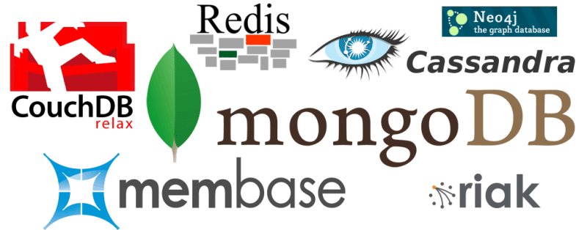
NoSQL Databases
Non-Relational Database Systems

Slide 51
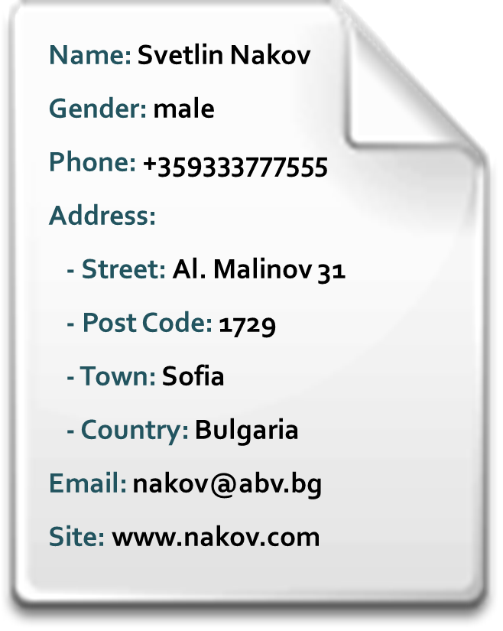
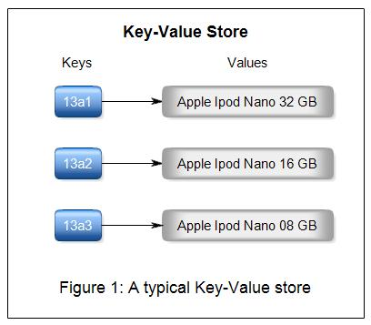

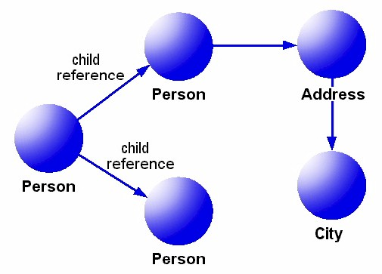
Non-Relational Data Models
Document model (e.g. MongoDB, CouchDB)
Set of documents, e.g. JSON strings
Key-value model (e.g. Redis)
Set of key-value pairs
Wide-column model (e.g. Cassandra)
Key-value model with schema
Object model (e.g. Caché)
Set of OOP-style objects

Slide 52

What is NoSQL Database?
NoSQL (non-relational) databases
Use document-based model (non-relational)
Schema-free document storage
Still support CRUD operations (create, read, update, delete)
Still support indexing and querying
Still supports concurrency and transactions
Highly optimized for append / retrieve
Great performance and scalability
NoSQL == “No SQL” or “Not Only SQL”?

Slide 53
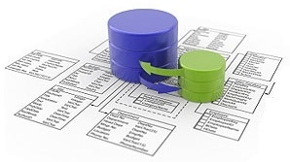

Relational vs. NoSQL Databases
Relational databases
Data stored as table rows
Relationships between related rows
Single entity spans multiple tables
RDBMS systems are very mature, rock solid
NoSQL databases
Data stored as documents
Single entity (document) is a single record
Documents do not have a fixed structure

Slide 54

Relational vs. NoSQL Models
Relational Model
Document Model
Name | Svetlin Nakov
Gender | male
Phone | +359333777555
Email | nakov@abv.bg
Site | www.nakov.com
Name: Svetlin Nakov
Gender: male
Phone: +359333777555
Address:
- Street: Tintyava 15-17
- Post Code: 1113
- Town: Sofia
- Country: Bulgaria
Email: nakov@abv.bg
Site: www.nakov.com
*
1
Street | Tintyava 15-17
Post Code | 1113
*
1
Town | Sofia
*
1
Country | Bulgaria

Slide 55




NoSQL Database Systems
Redis
Ultra-fast in-memory data structures server
MongoDB
Mature and powerful JSON-document database
CouchDB
JSON-based document database with REST API
Cassandra
Distributed wide-column database
DB Ranking: http://db-engines.com/en/ranking

Slide 56


Summary / Questions
What is relational database?
Examples of RDBMS?
What is E/R data model?
What is primary key?
What relationships do you know?
What is constraint?
What is transaction?
What is NoSQL database?
Examples?
Databases

Slide 57









Database Systems
https://softuni.bg/courses/databases

Slide 58
License
This course (slides, examples, demos, videos, homework, etc.) is licensed under the "Creative Commons Attribution-NonCommercial-ShareAlike 4.0 International" license
Attribution: this work may contain portions from
"Databases" course by Telerik Academy under CC-BY-NC-SA license

Slide 59





Free Trainings @ Software University
Software University Foundation – softuni.org
Software University – High-Quality Education, Profession and Job for Software Developers
softuni.bg
Software University @ Facebook
facebook.com/SoftwareUniversity
Software University @ YouTube
youtube.com/SoftwareUniversity
Software University Forums – forum.softuni.bg

